Slide 1
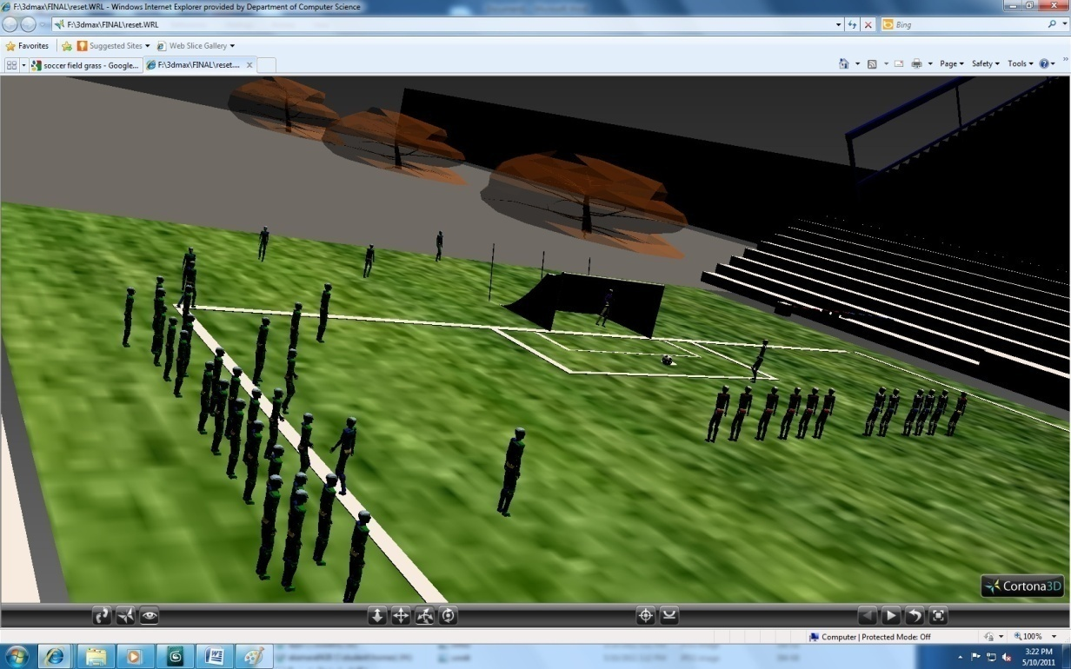
VR Group Presentation Final Project
Topic: Interactive Soccer penalty Shot
Group Members
Jeffrey Averett, Abu Kamara, Ronald Sumner

Slide 2
Why is virtual reality the appropriate technology? Why is this a useful application?
Virtual reality is the appropriate technology because of the tools it posses which allows users to simulate the objective and goals without actually being on the soccer field. 3Ds Max and VRML were useful because of their user friendly environment and GUI.

Slide 3
Presentation Goal and Objectives
GOAL AND OBJECTIVES:
A simulation of soccer penalty kick.
When you click on a player, he will walk towards the soccer ball and stand in a position of kicking the ball towards the goal. At the same time, the goal keeper of the other team walk towards the goal post and stand in position of catching the ball or preventing it from entering the goal. When you click a button, the ball will shoot towards the goal while the goal keeper attempt to block the shot from entering the goal. After the shot is taken user will also click a button to reset the field.

Slide 4

Modeling and Animation Tools
3Ds Max-Geometry(Planes & Boxes), Stairs, Railing, walls, foliage, Soccer-goal, Lights(Daylight System) and Textures(Field, pillars, walls, and planes)

Slide 5


Slide 6
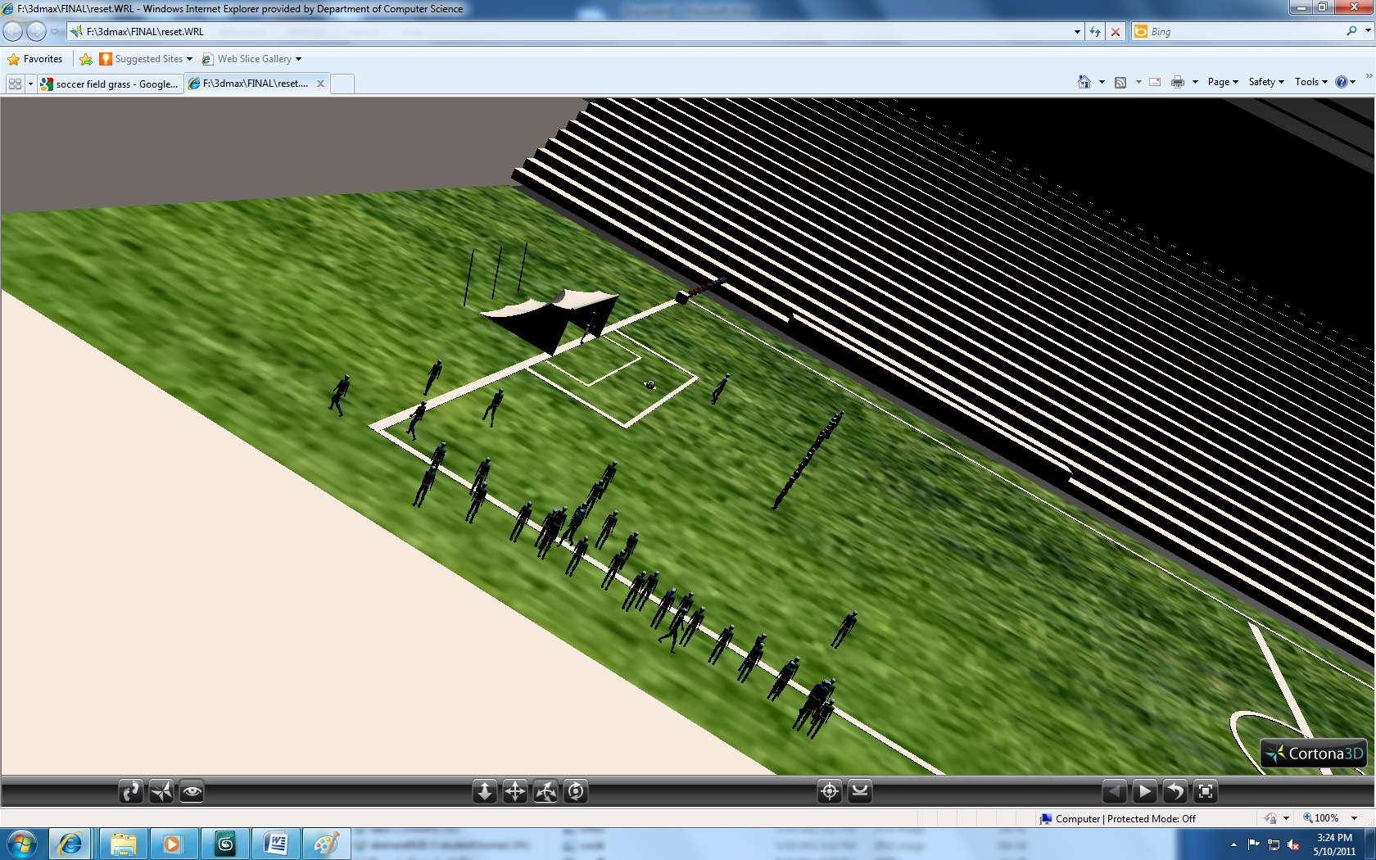

Slide 7
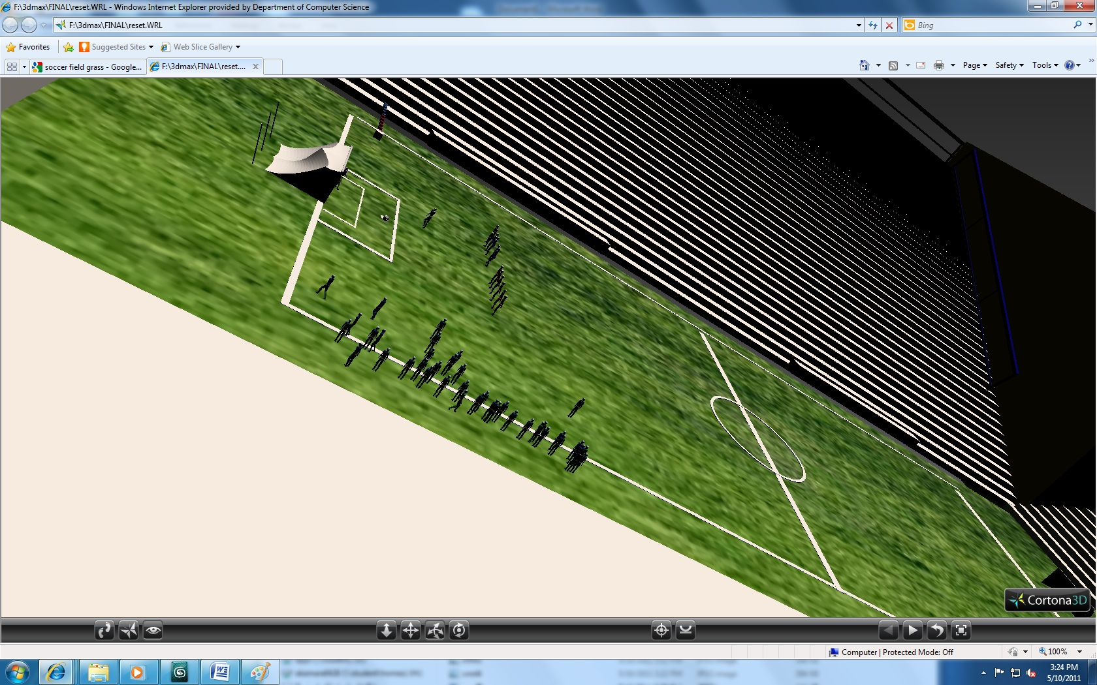

Slide 8
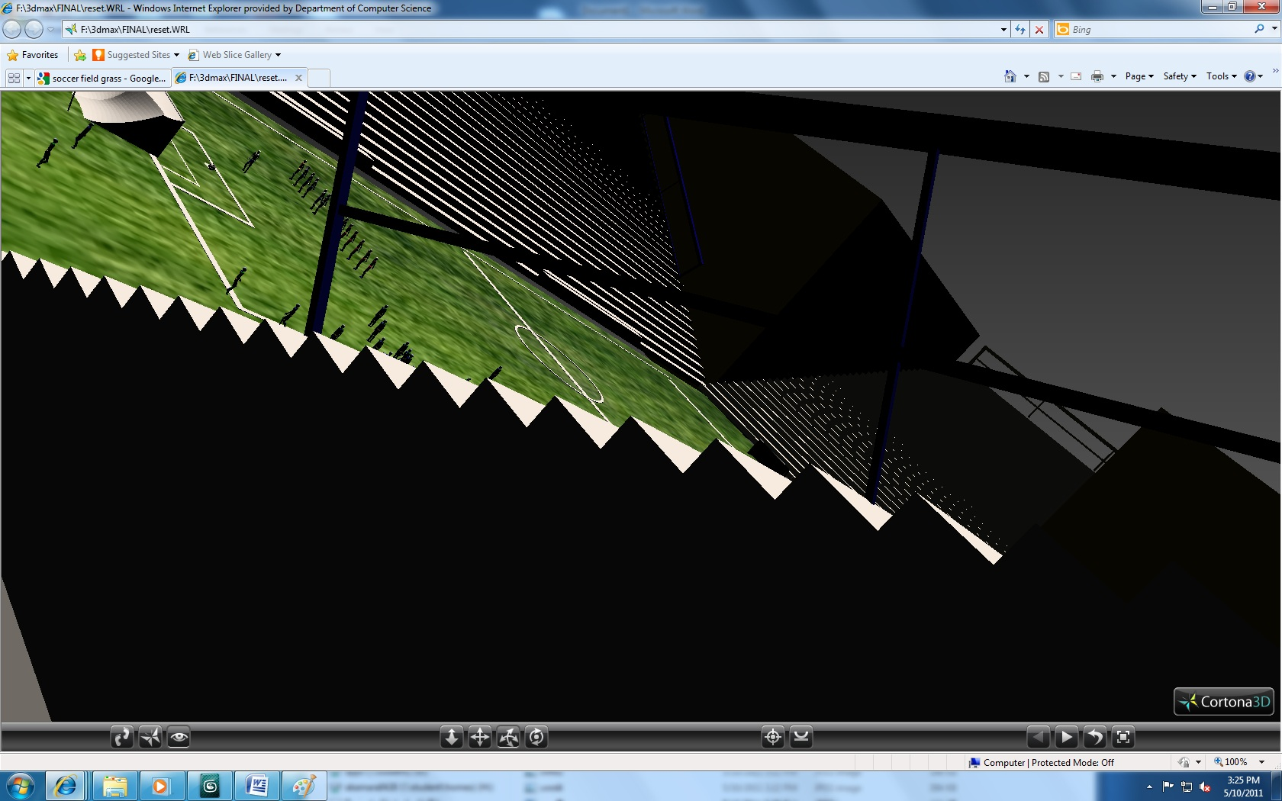

Slide 9
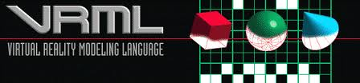
Modeling and Animation Tools
VRML-Major animation: Sensors(touch & anchor)

Slide 10
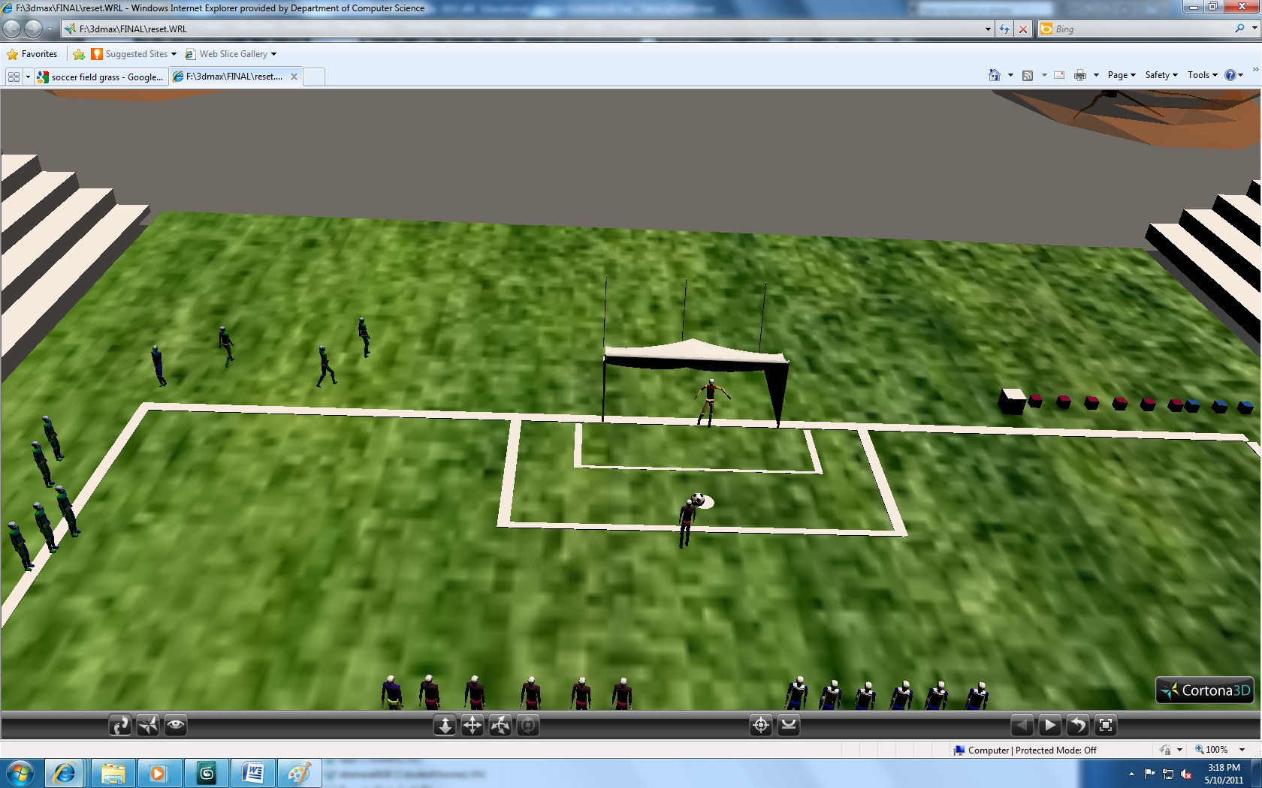

Slide 11
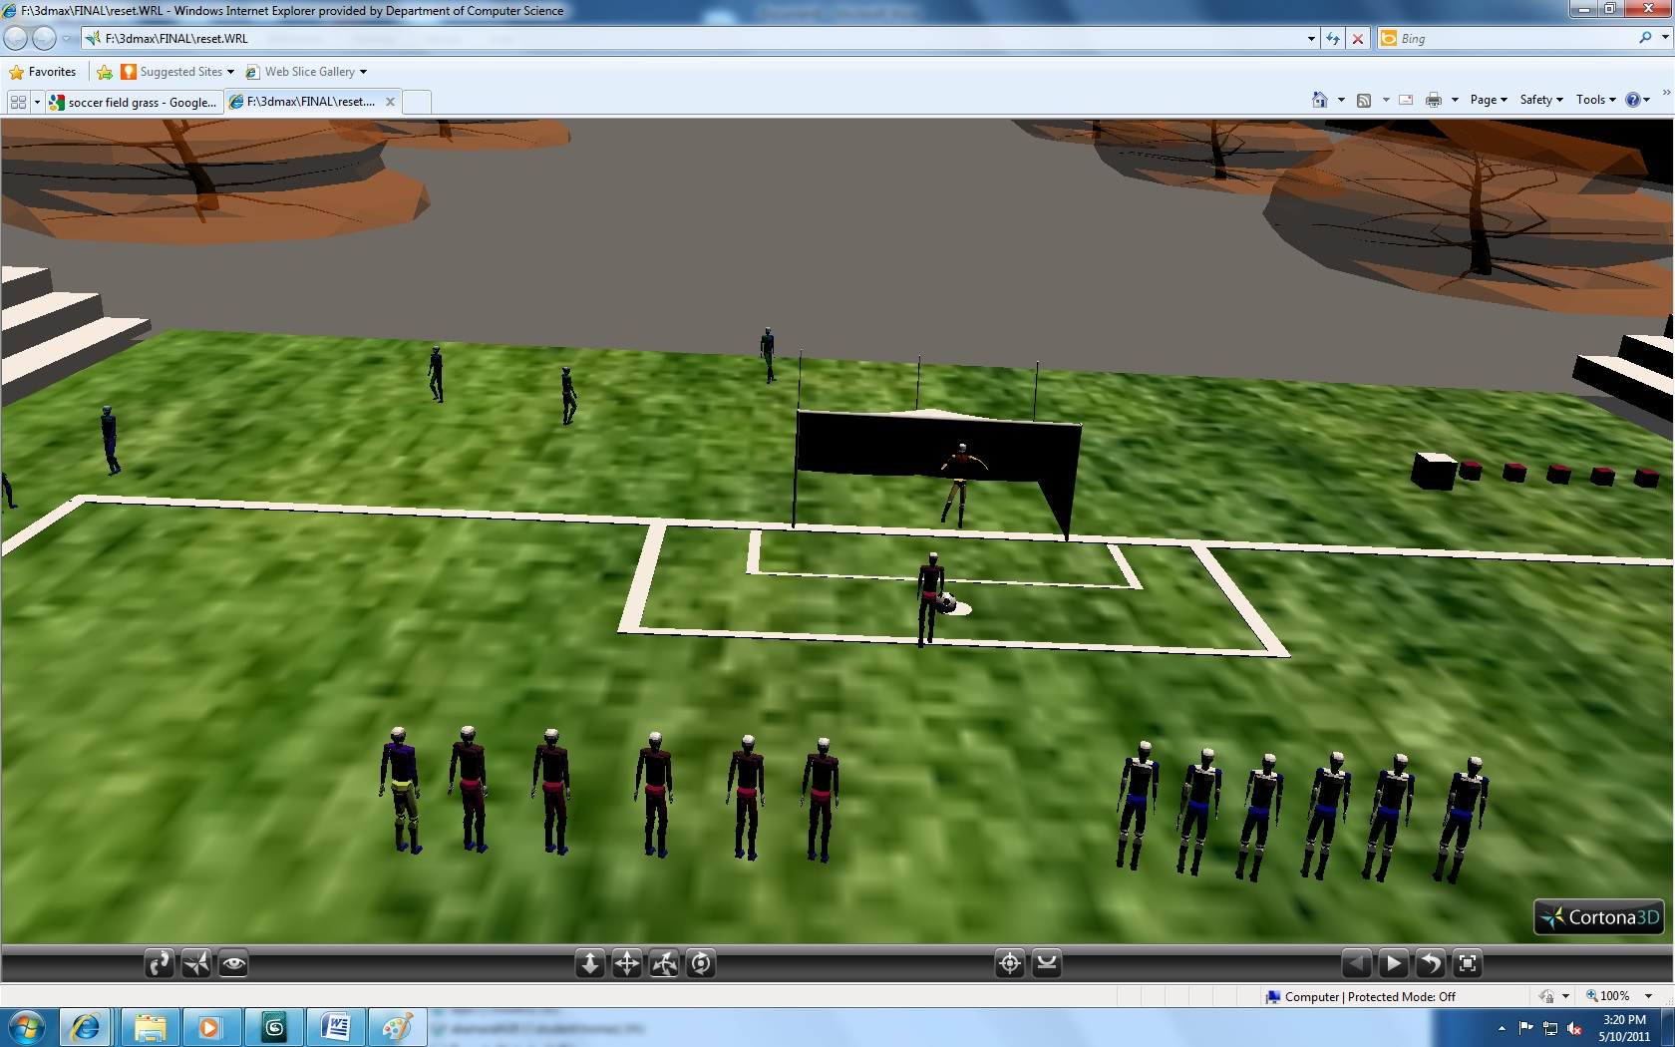

Slide 12
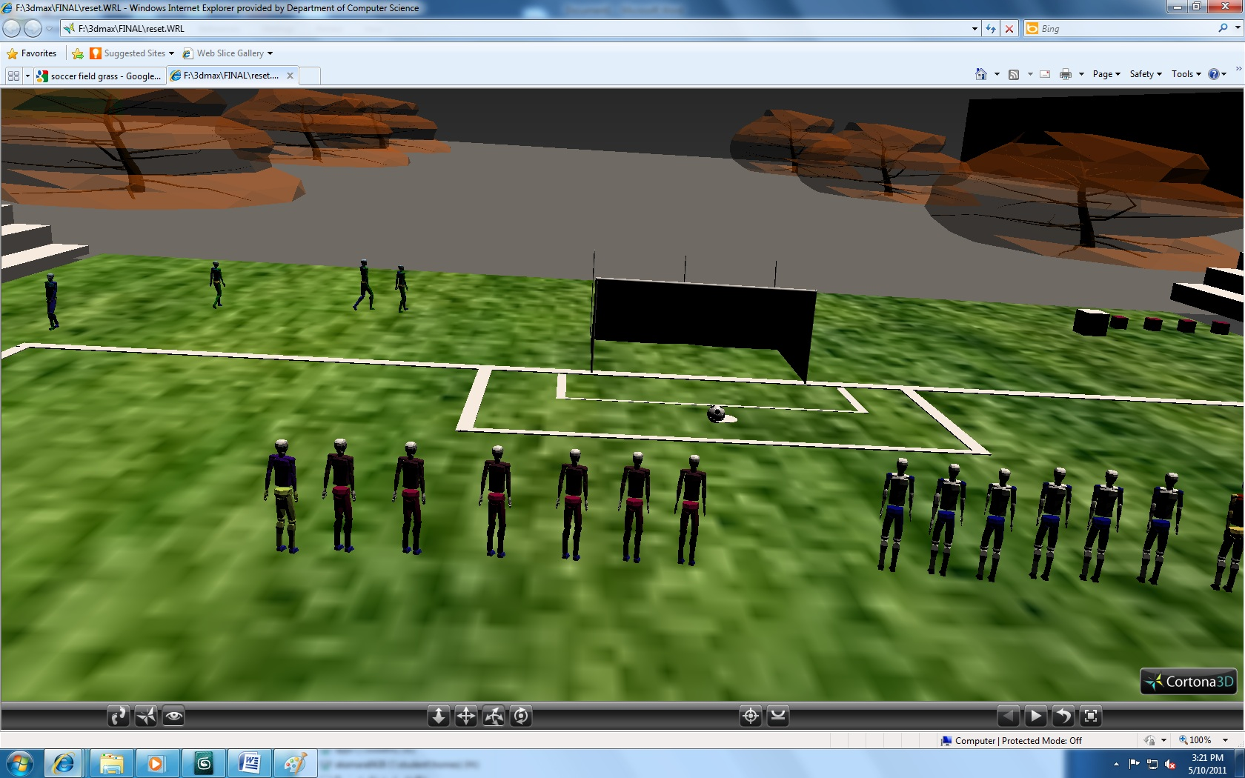

Slide 13
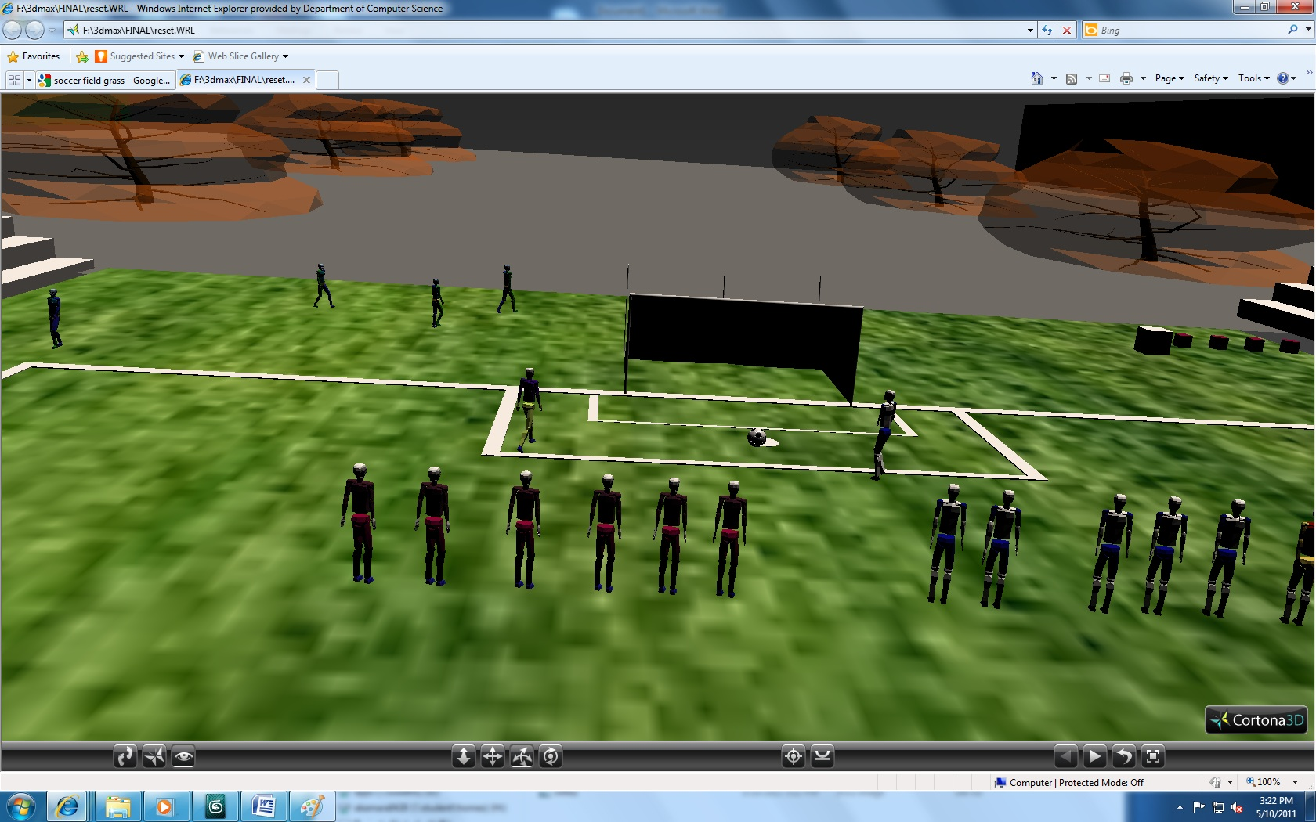

Slide 14
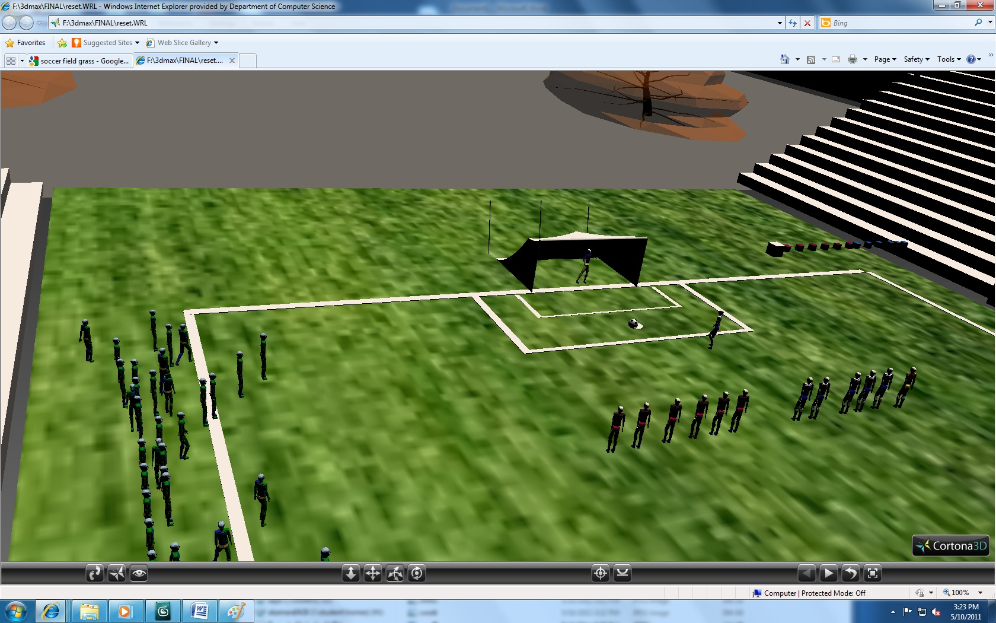

Slide 15
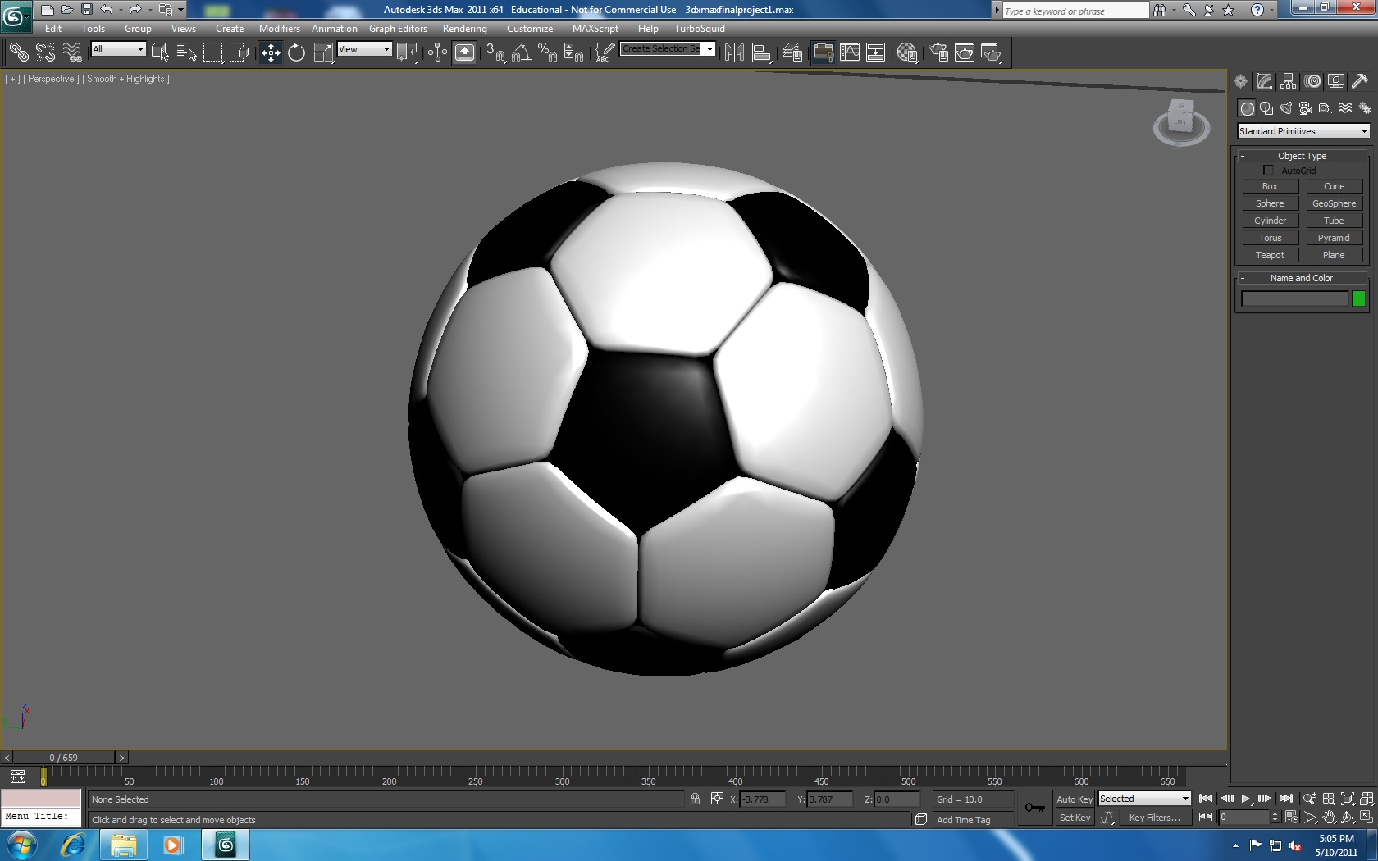

Slide 16
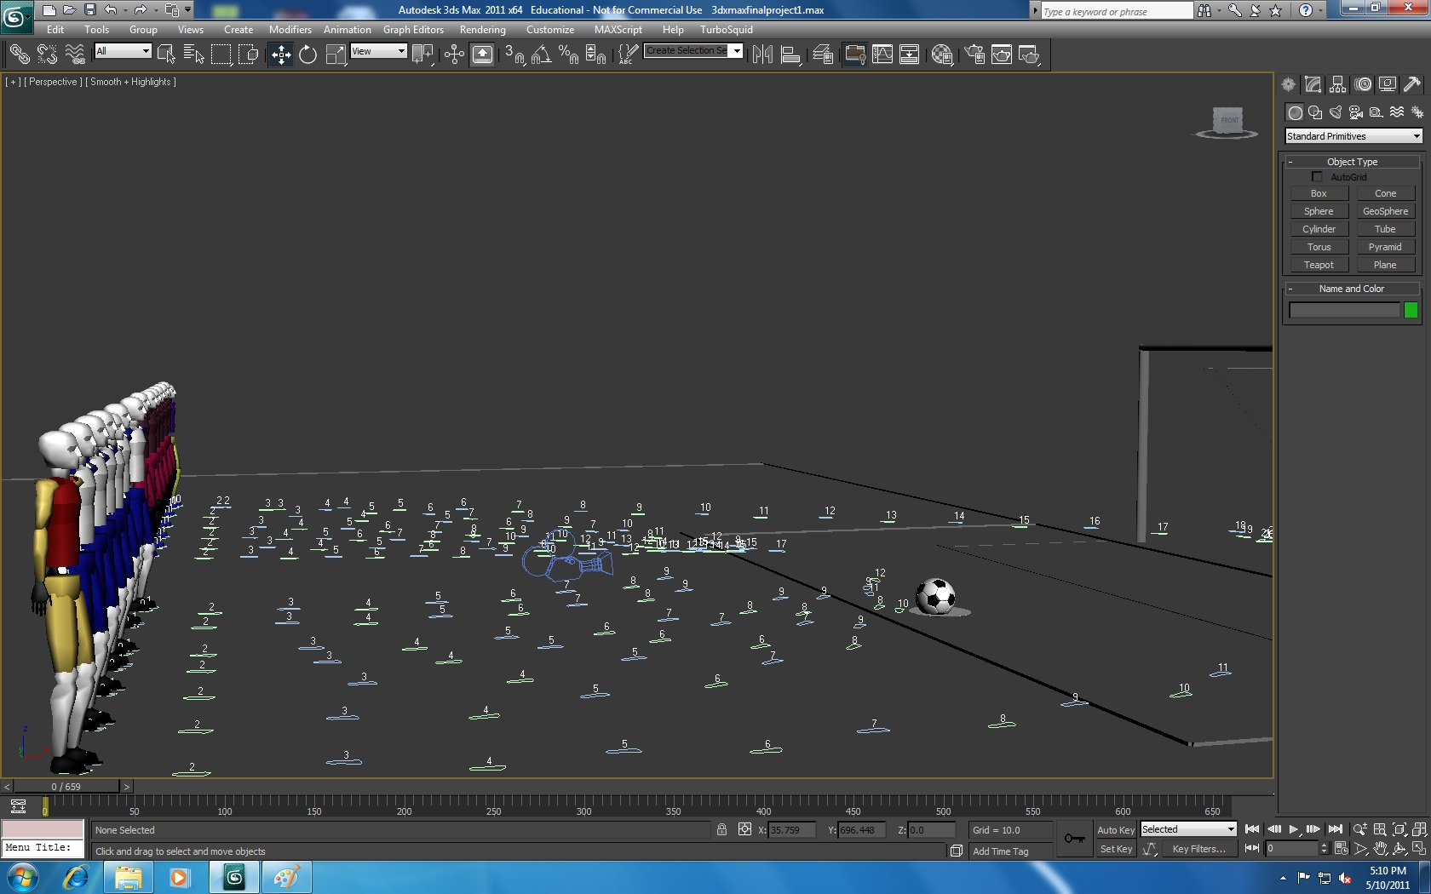

Slide 17
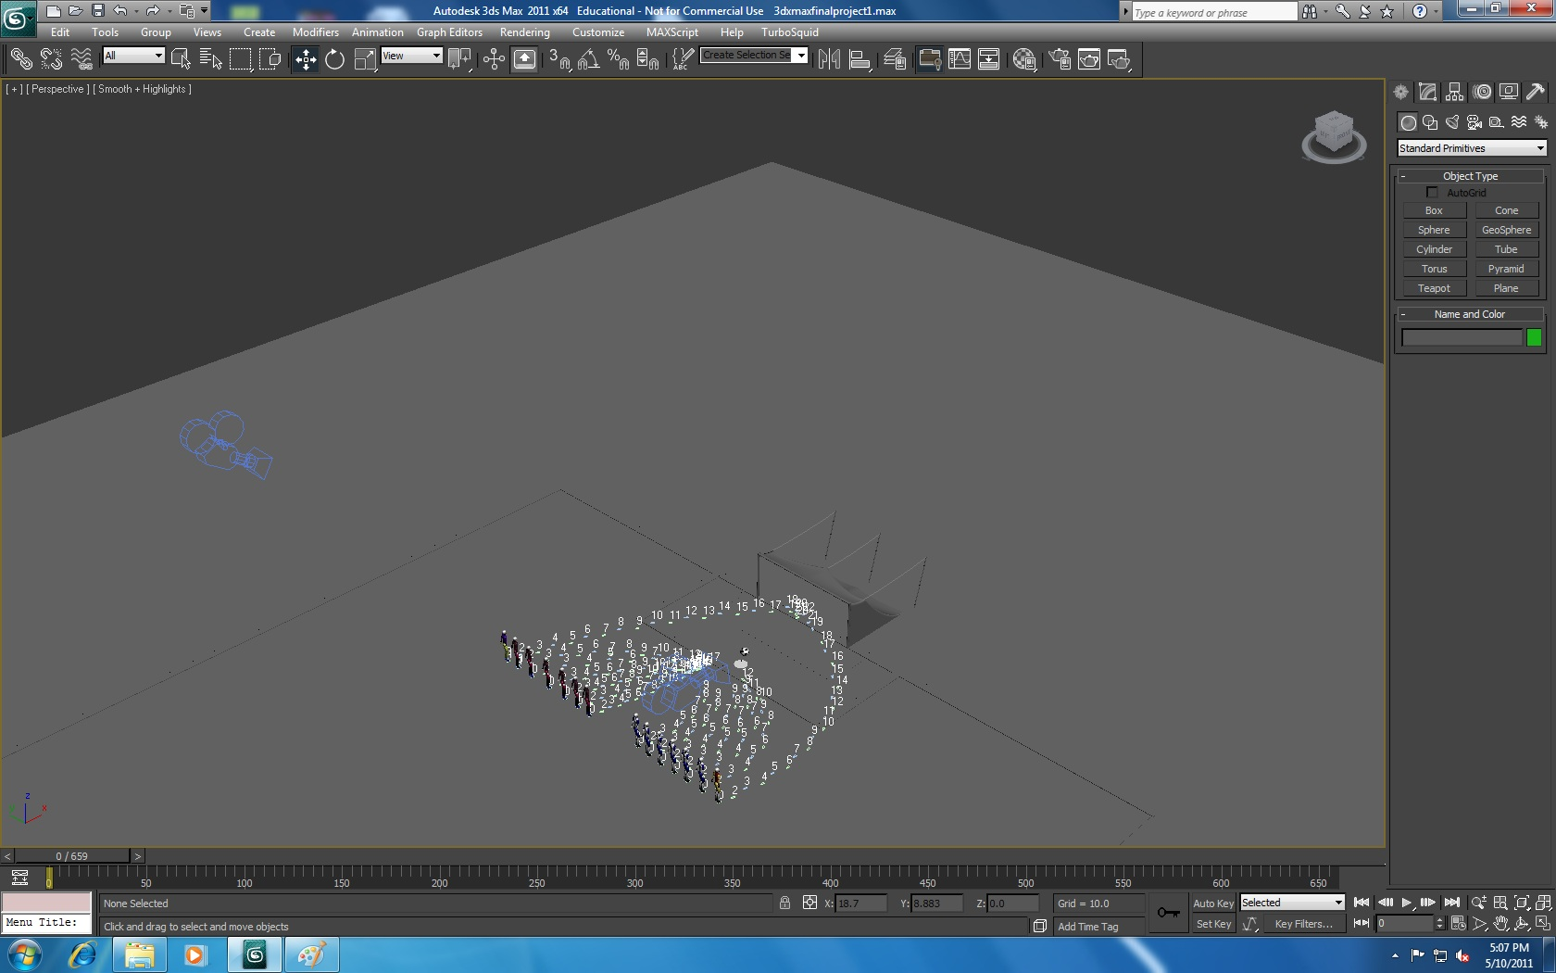

Slide 18
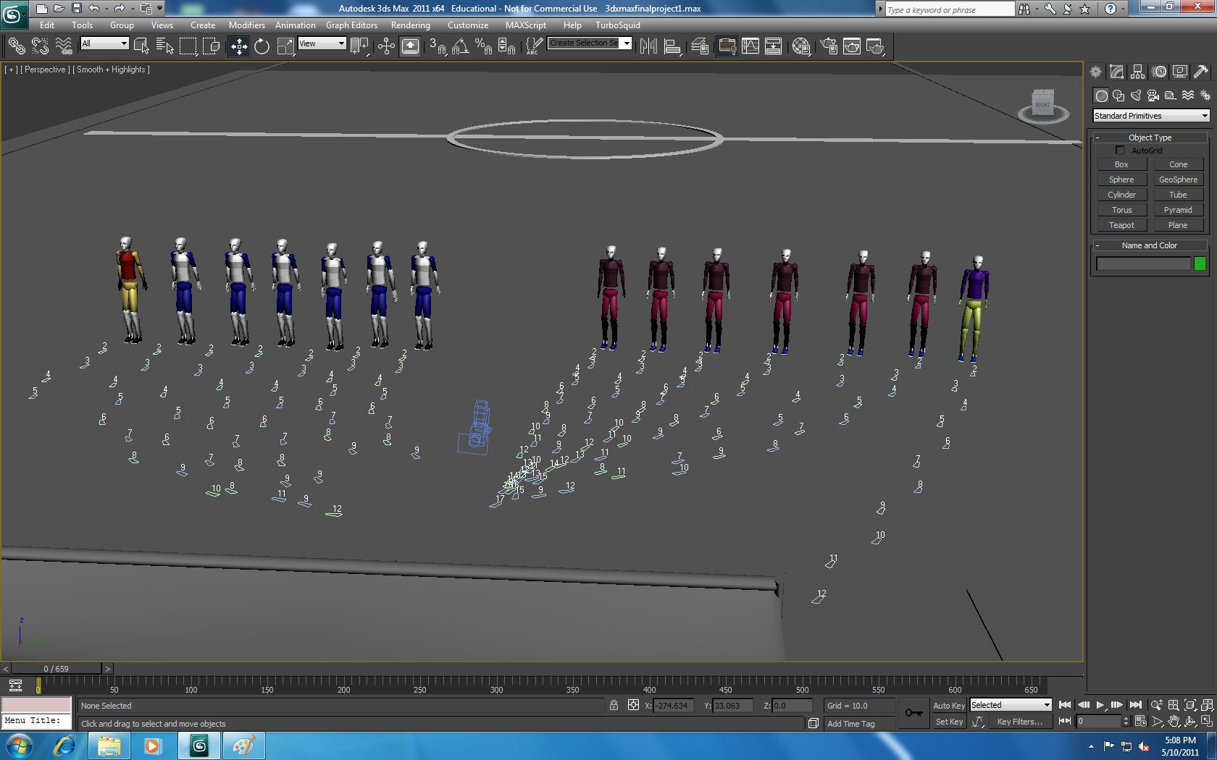

Slide 19
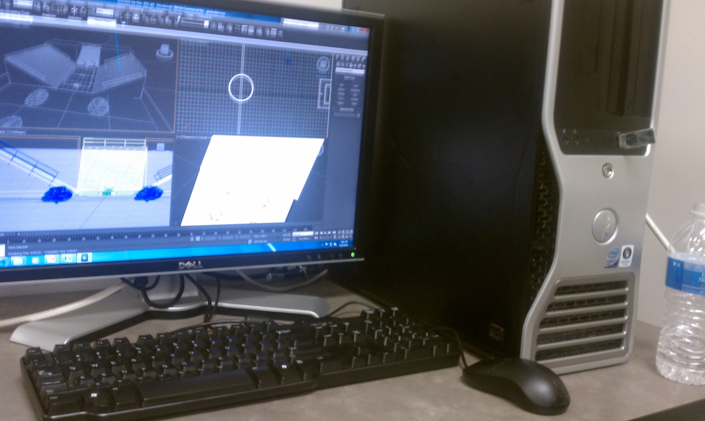
Software & Hardware Used
Desktop Dell Precision T3400 Intel Core 2 Quad, 8GB RAM

Slide 20
Problems encountered? remaining shortcomings?
Adding lines to field
Adding skin to model
Animating players
Modeling field
Adding textures
Adding amenities
Crowd simulation

Slide 21
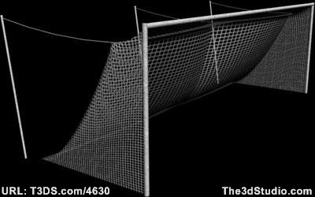
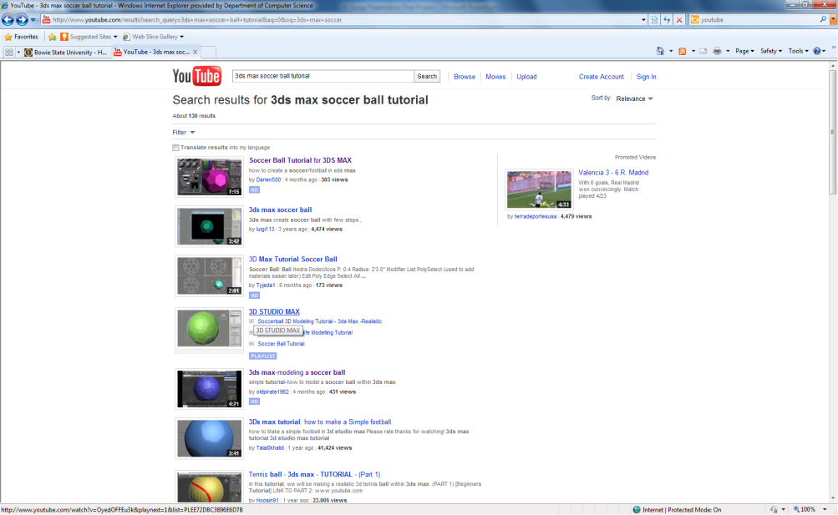
References
Soccer goal obtained from the 3D Studio (www.3dstudio.com)
Soccer ball tutorial from youtube.com

